Slide 1
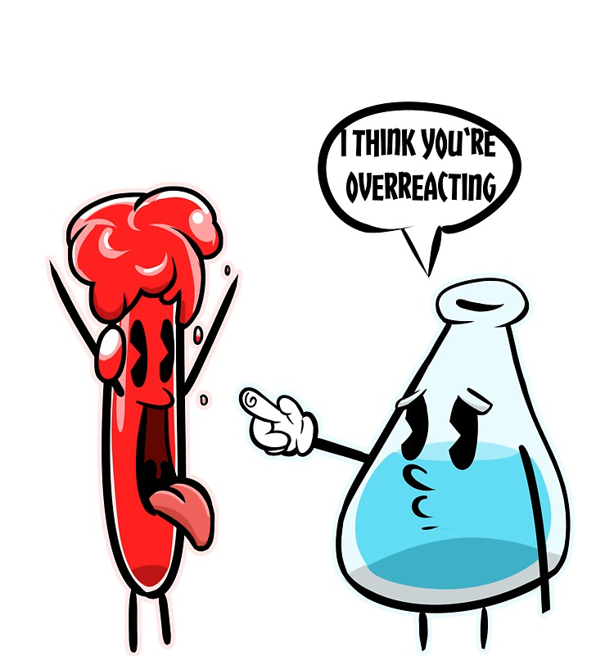
COBALT
Adela Zemková

Slide 2
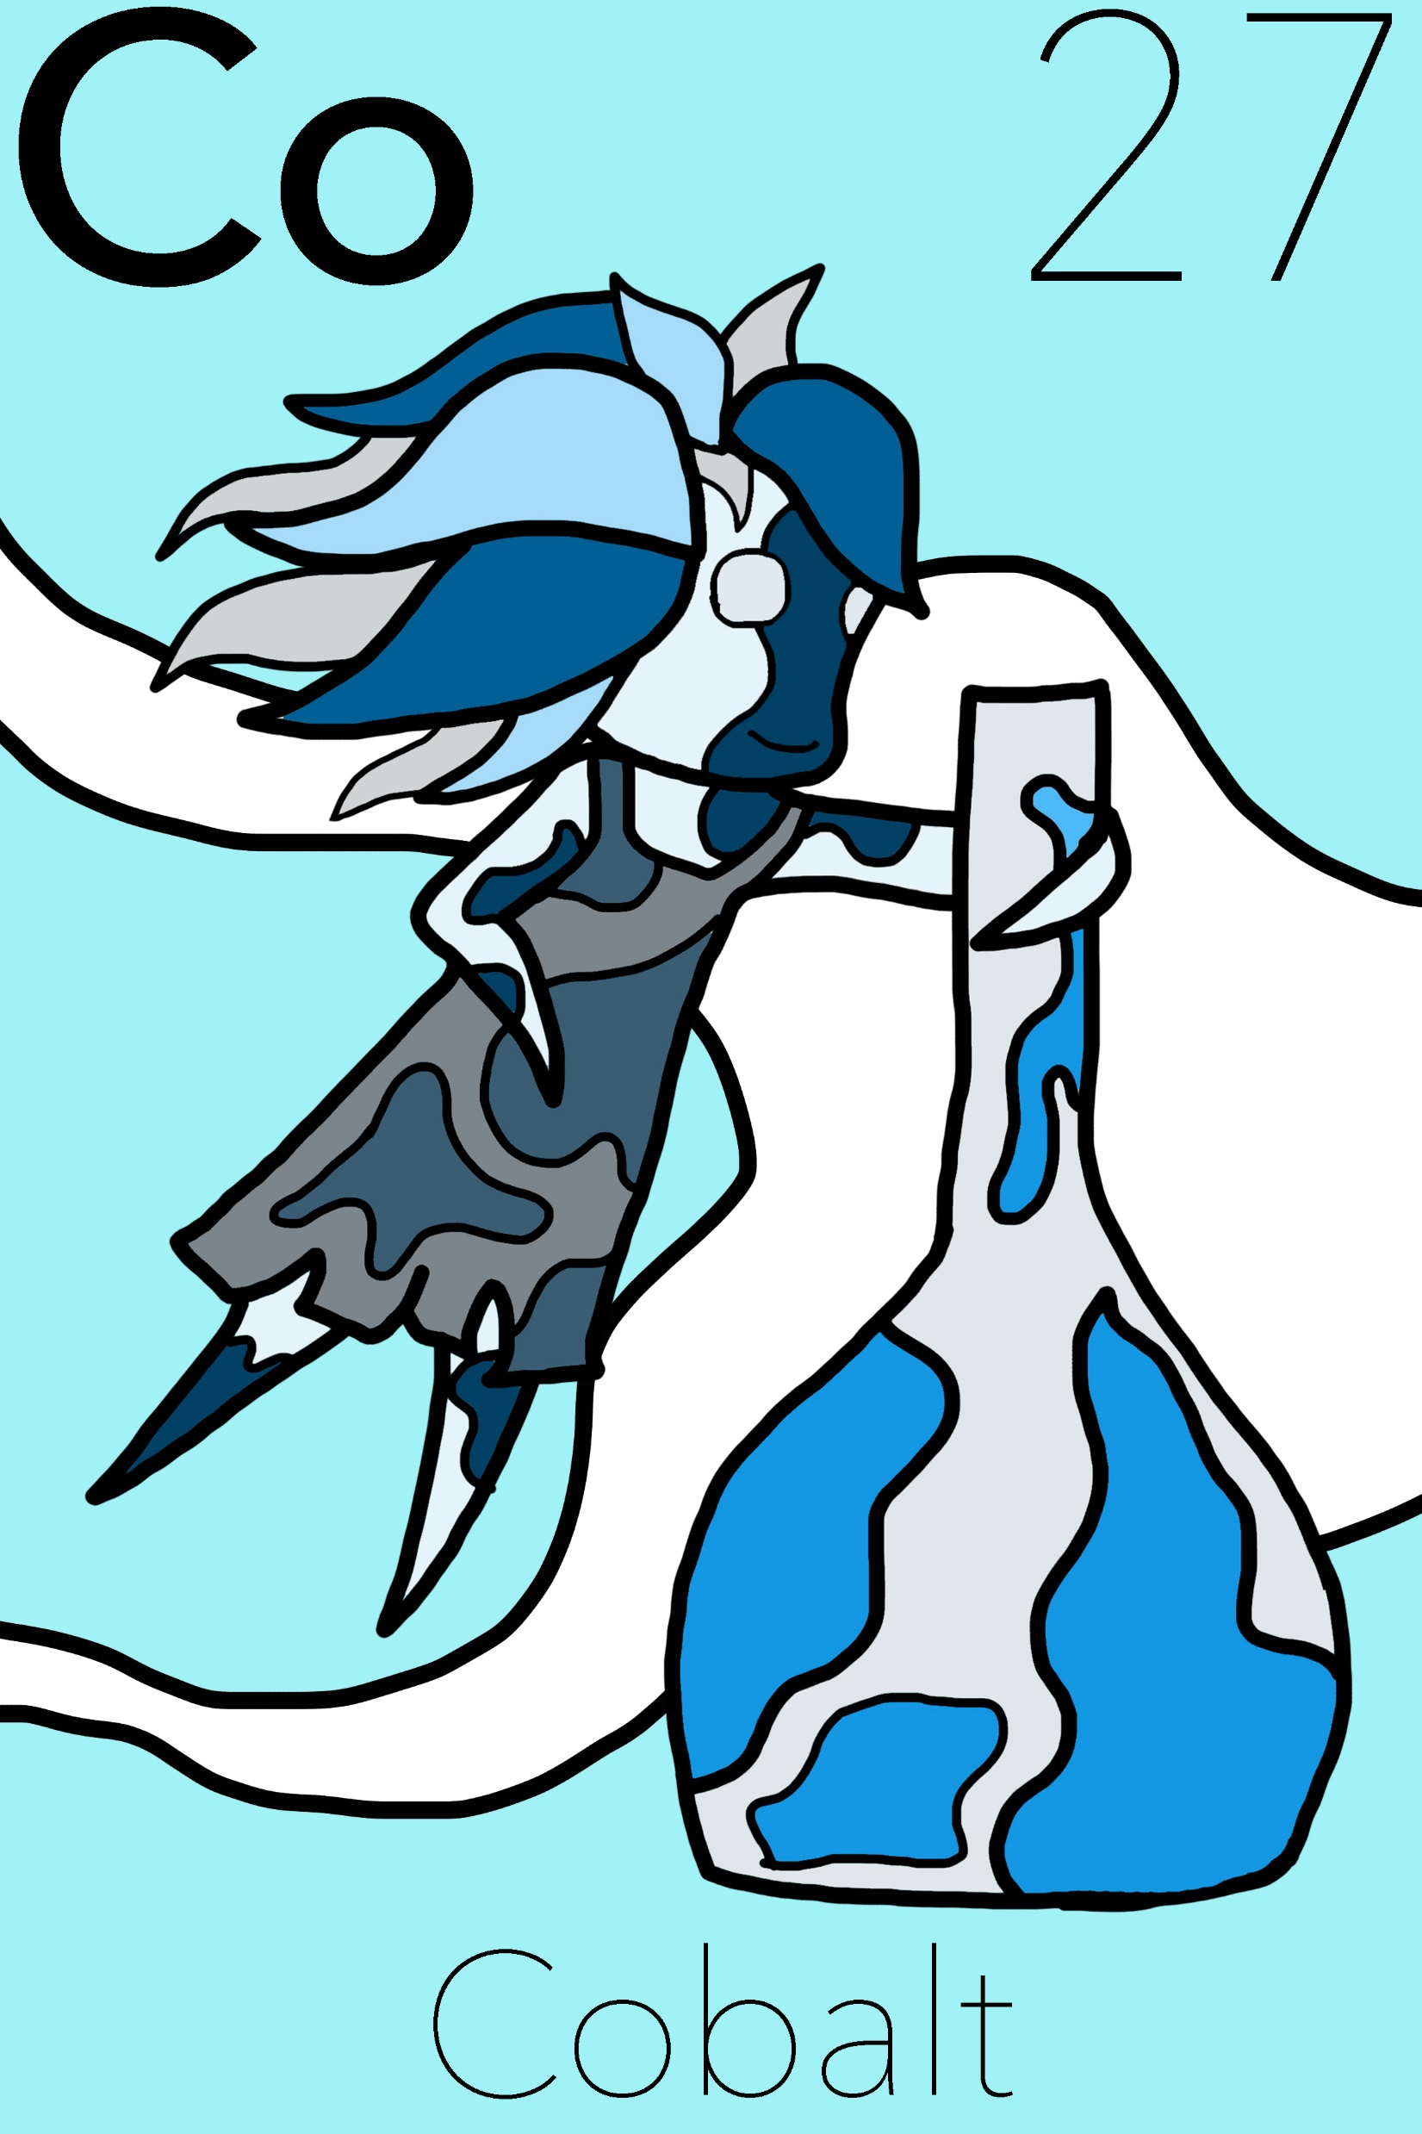
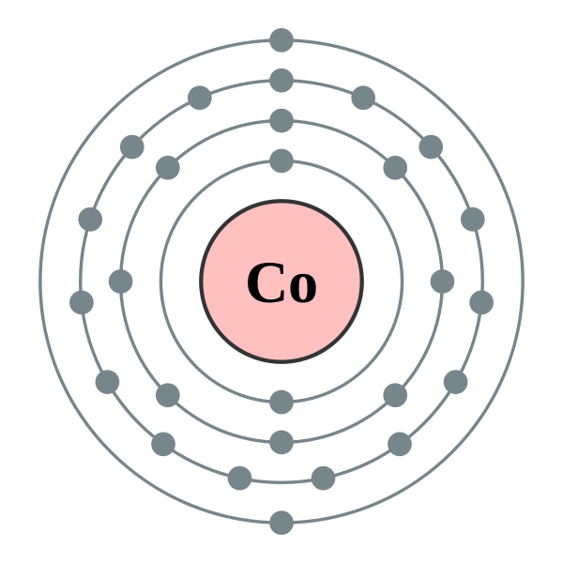
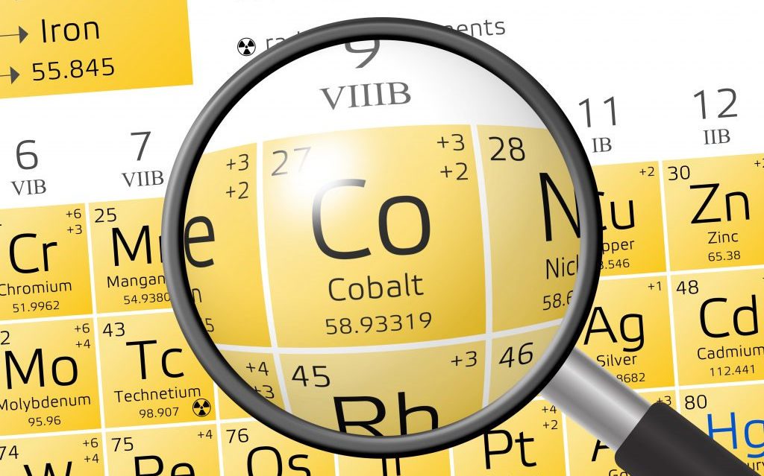
Basic information
symbol Co, atomic number 27
transitional metal of Group 9 (VIII B)
solid, crystal structure
lustrous, silvery-blue, ferromagnetic
resistant to corrosion
relatively unreactive
carcinogenic in large doses

Slide 3
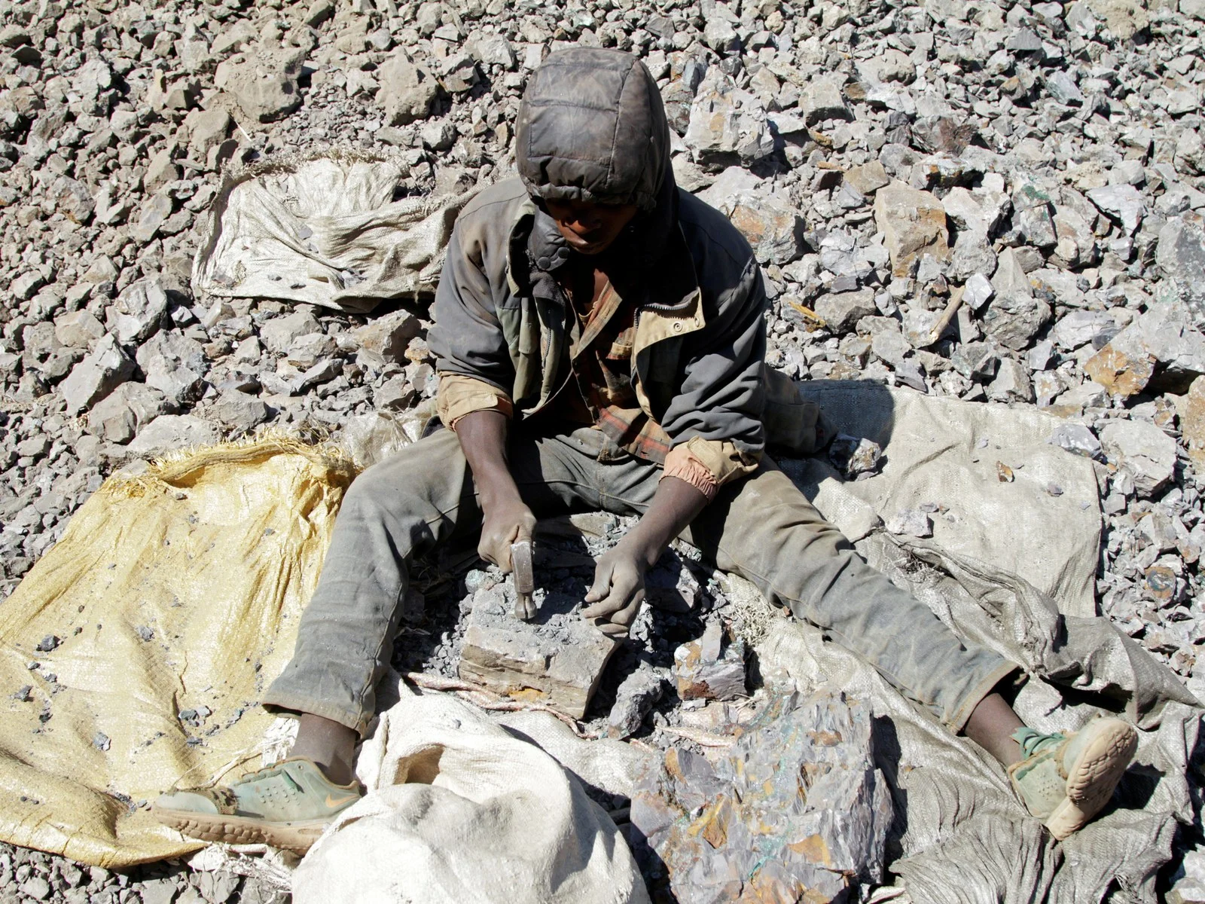
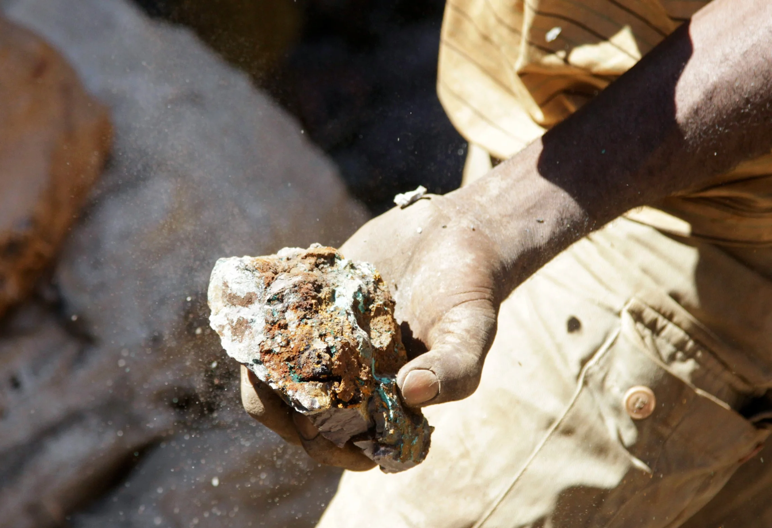
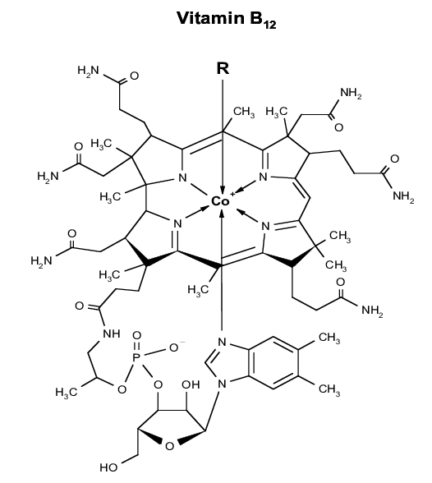
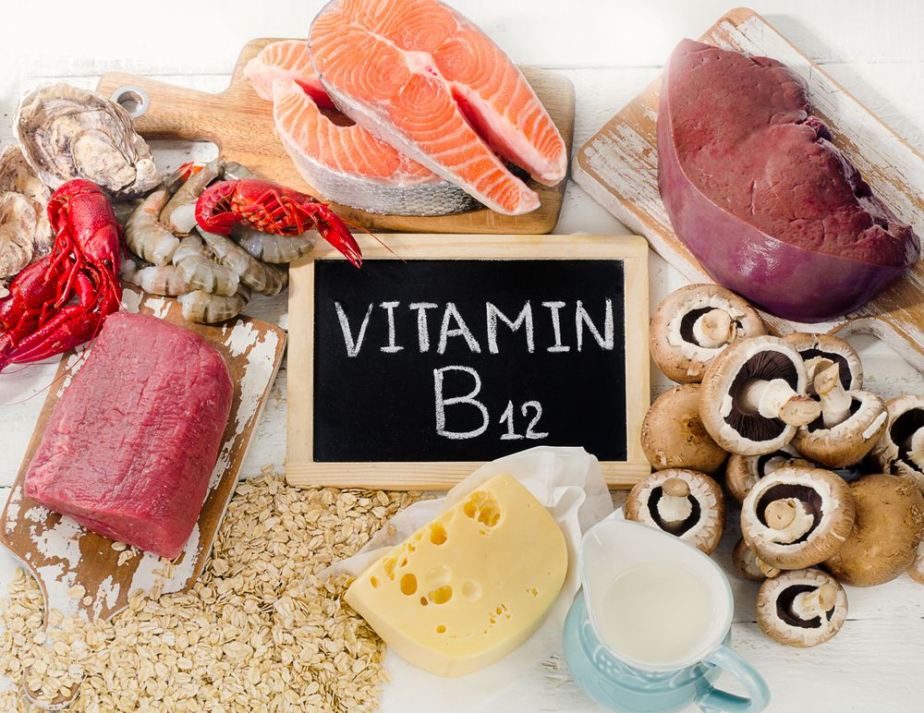
Occurence
rare element of the earth's crust
essential to mammals in the form of cobalamin = vitamin B₁₂
in the Sun and stellar atmospheres
in combination with other elements in crusts deep in the oceans, soils, plants, animals, minerals

Slide 4
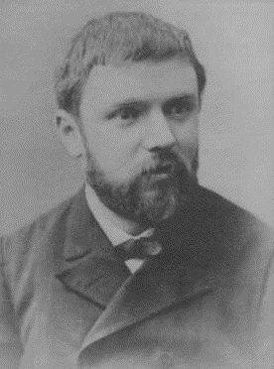
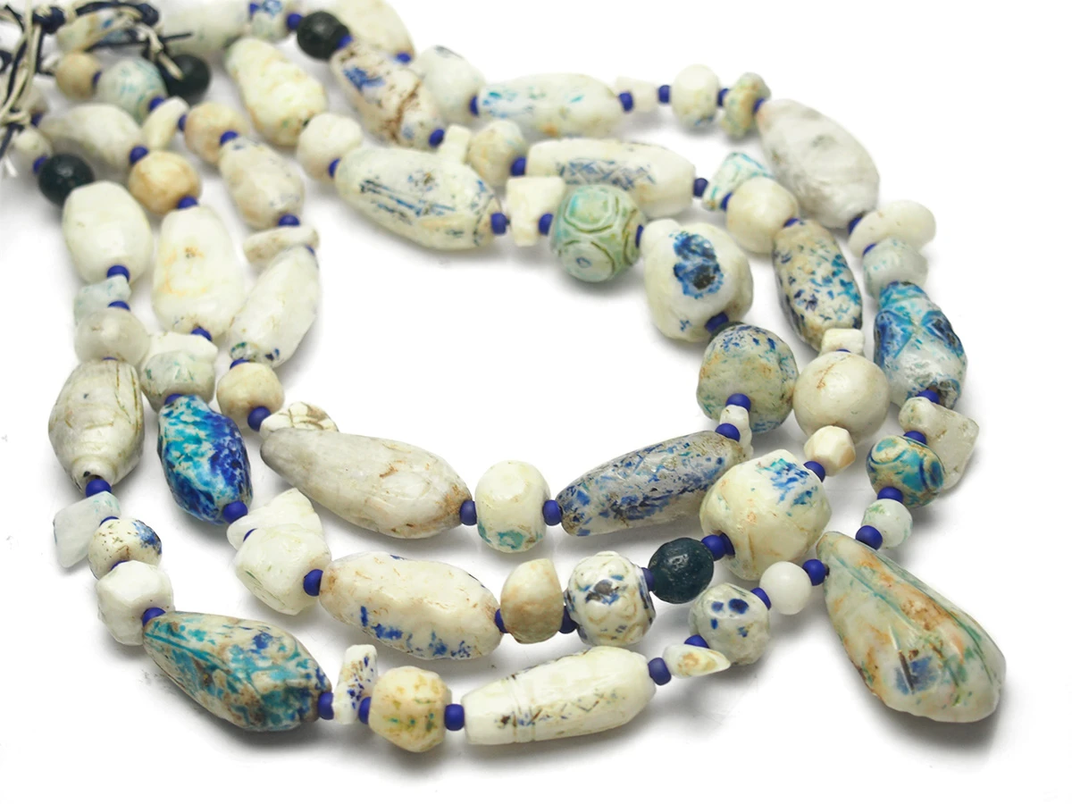
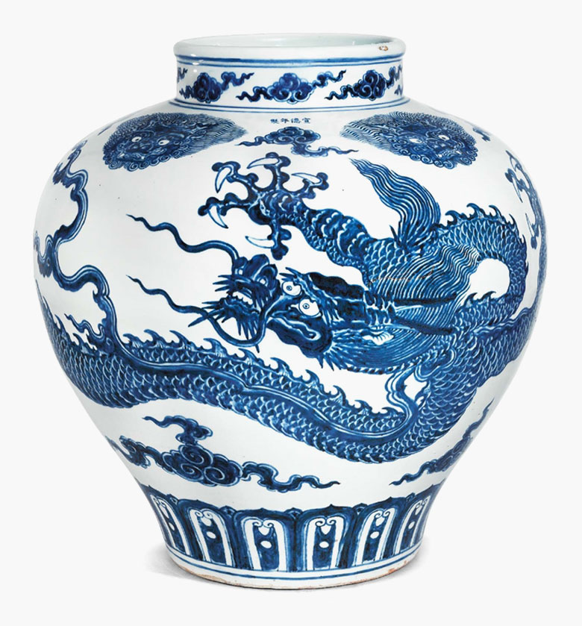
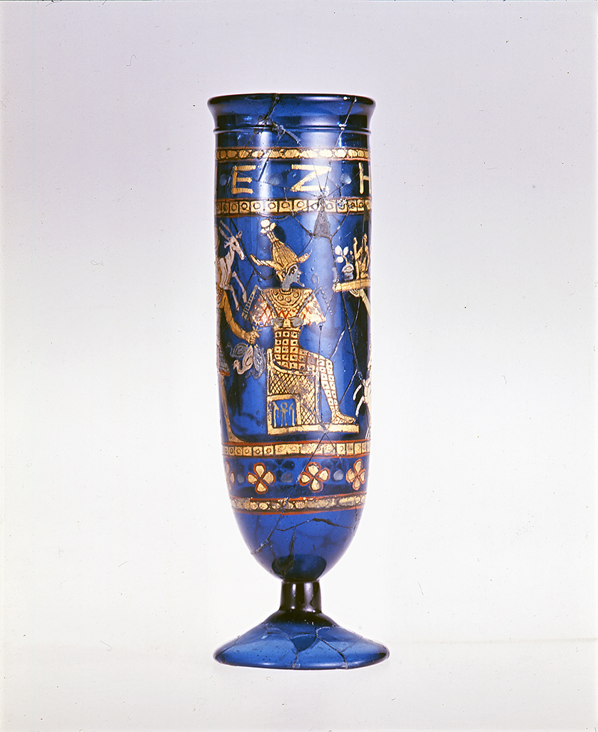
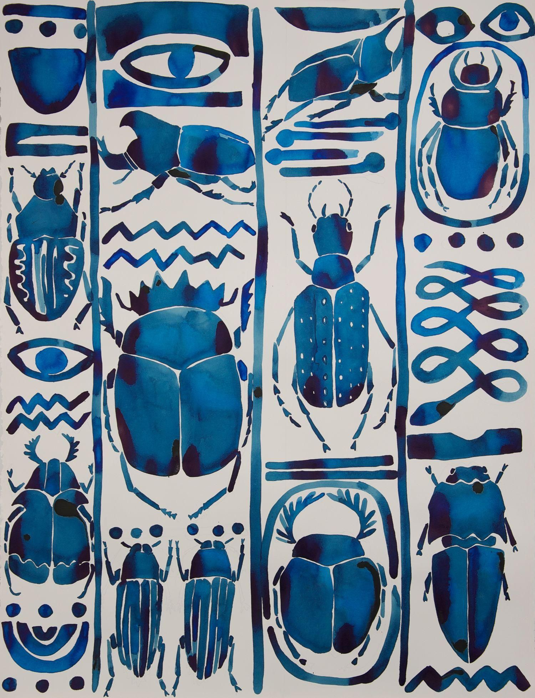
History
isolated by Swedish chemist Georg Brandt – 1735
detected in Egyptian statuettes
Persian necklace beads
in the blue porcelain of the Ming dynasty…

Slide 5
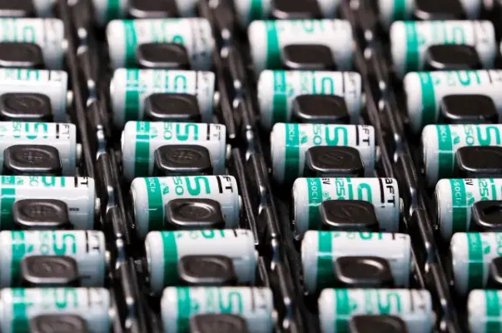
Usage
To colour porcelain, glass, ceramics, paint, pottery
manufacture of alloys, elastic alloys - precision hairsprings and hard metals
rechargeable batteries to power phones, robots and electric cars

Slide 6
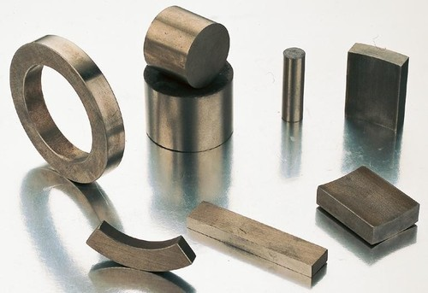
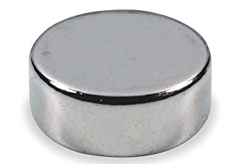
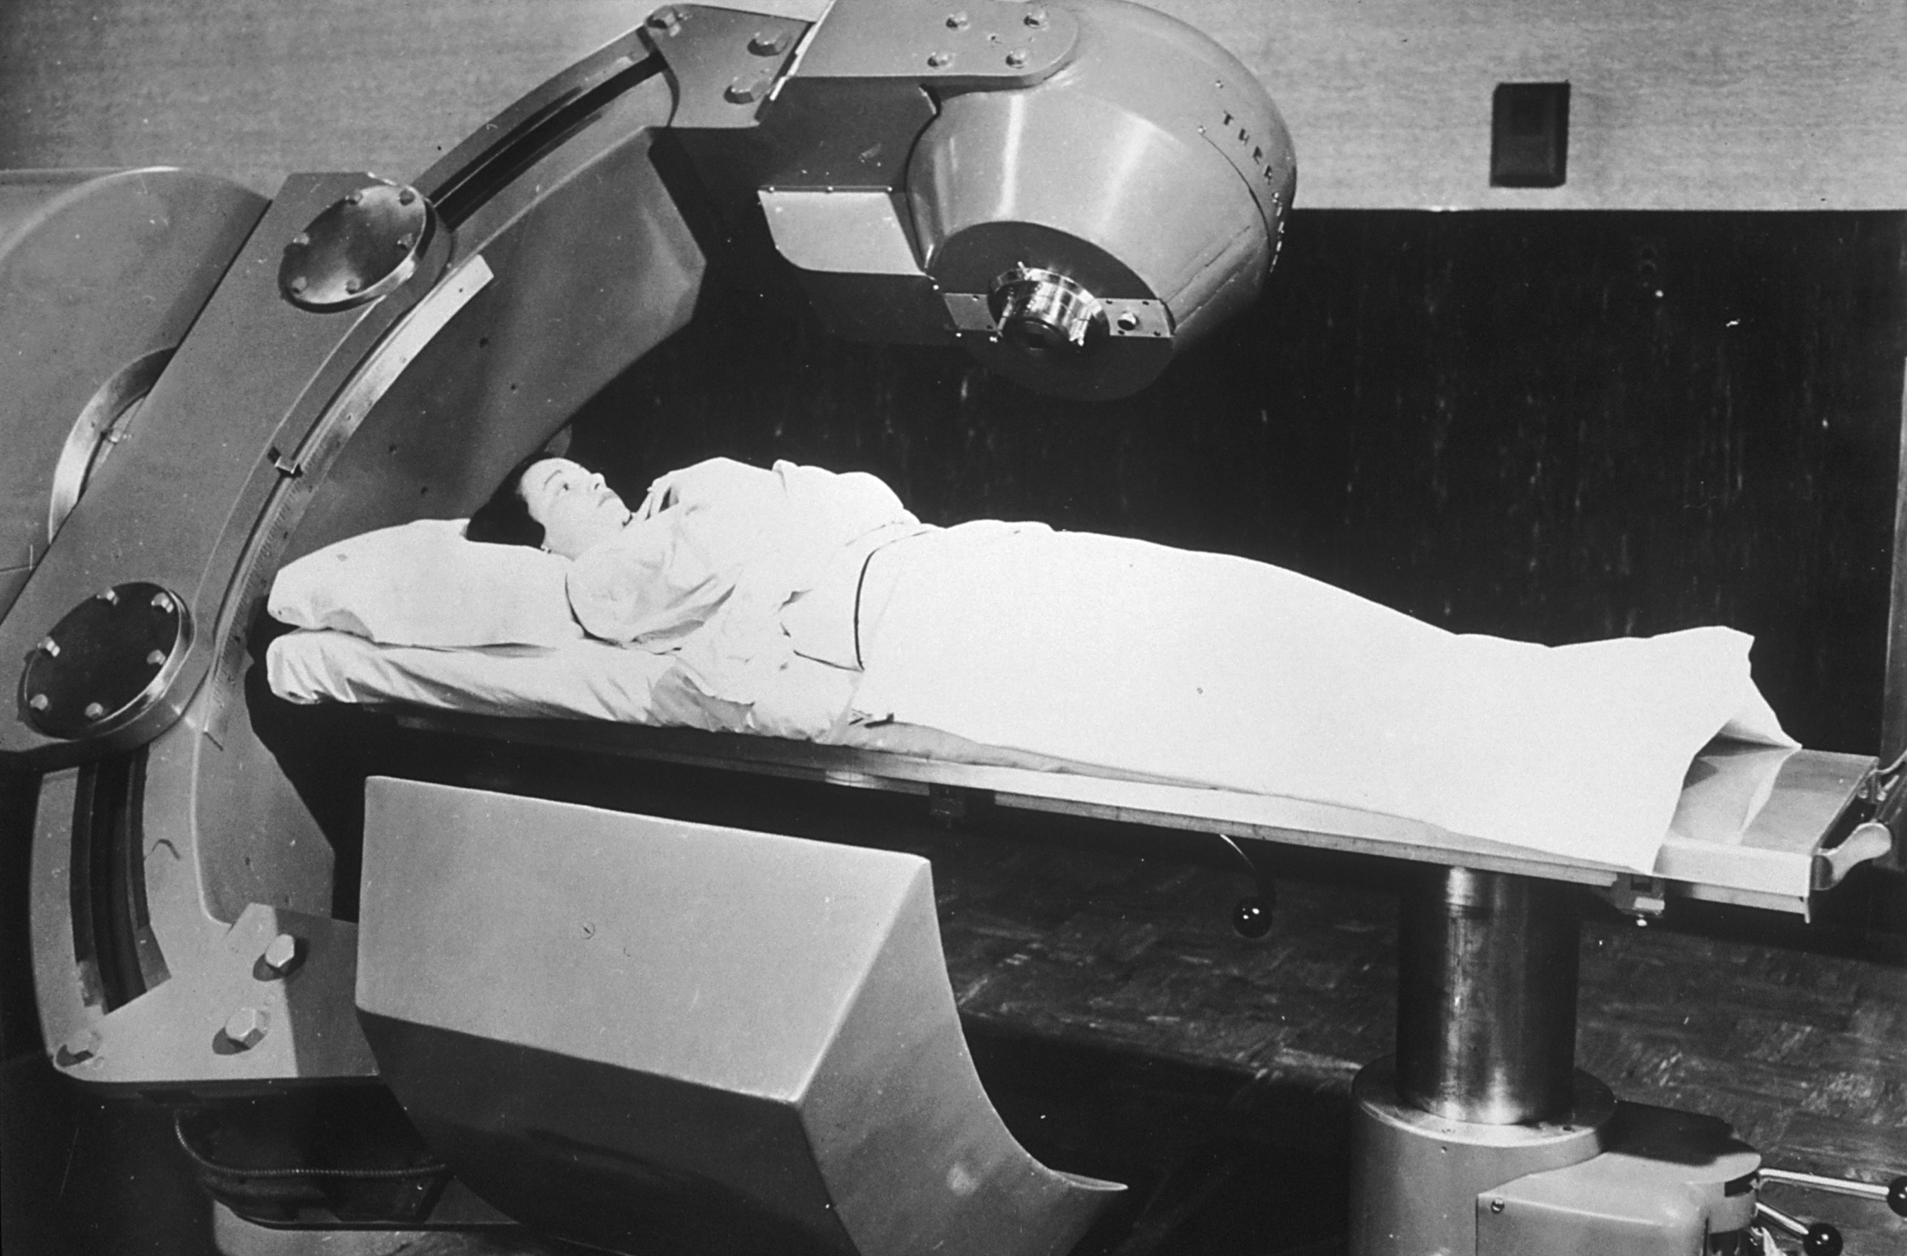
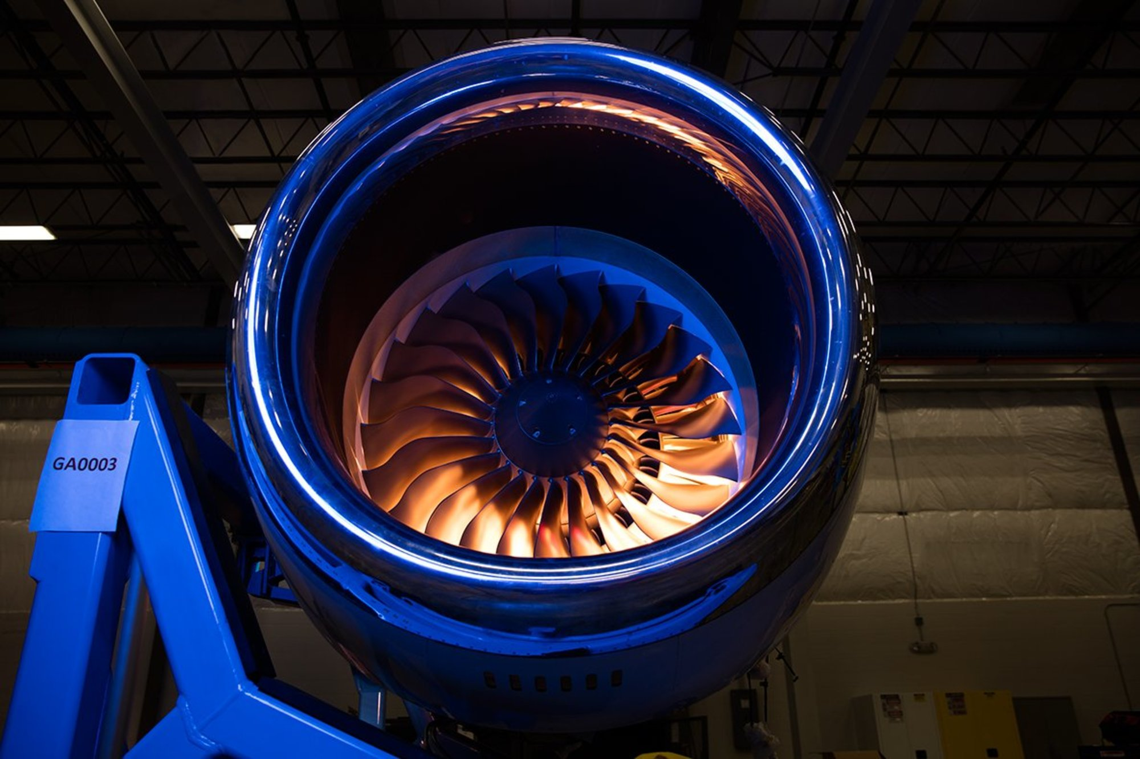
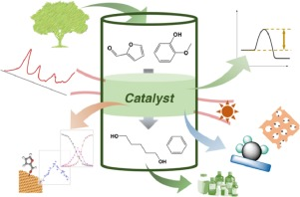
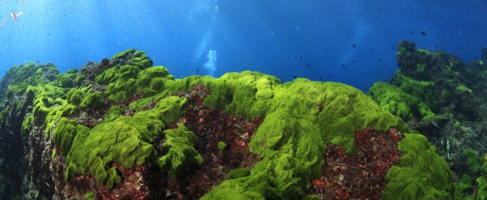
Usage
gamma-rays used in X- rays, for cancer therapy and as a radioactive tracer
make magnets
in jet turbines and gas turbine generators
catalyst
micronutrient for bacteria, algae, and fungi

Slide 7
Thanks for your attention

