Slide 1
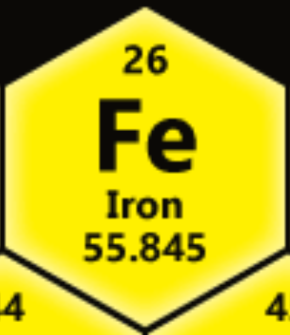

Slide 2
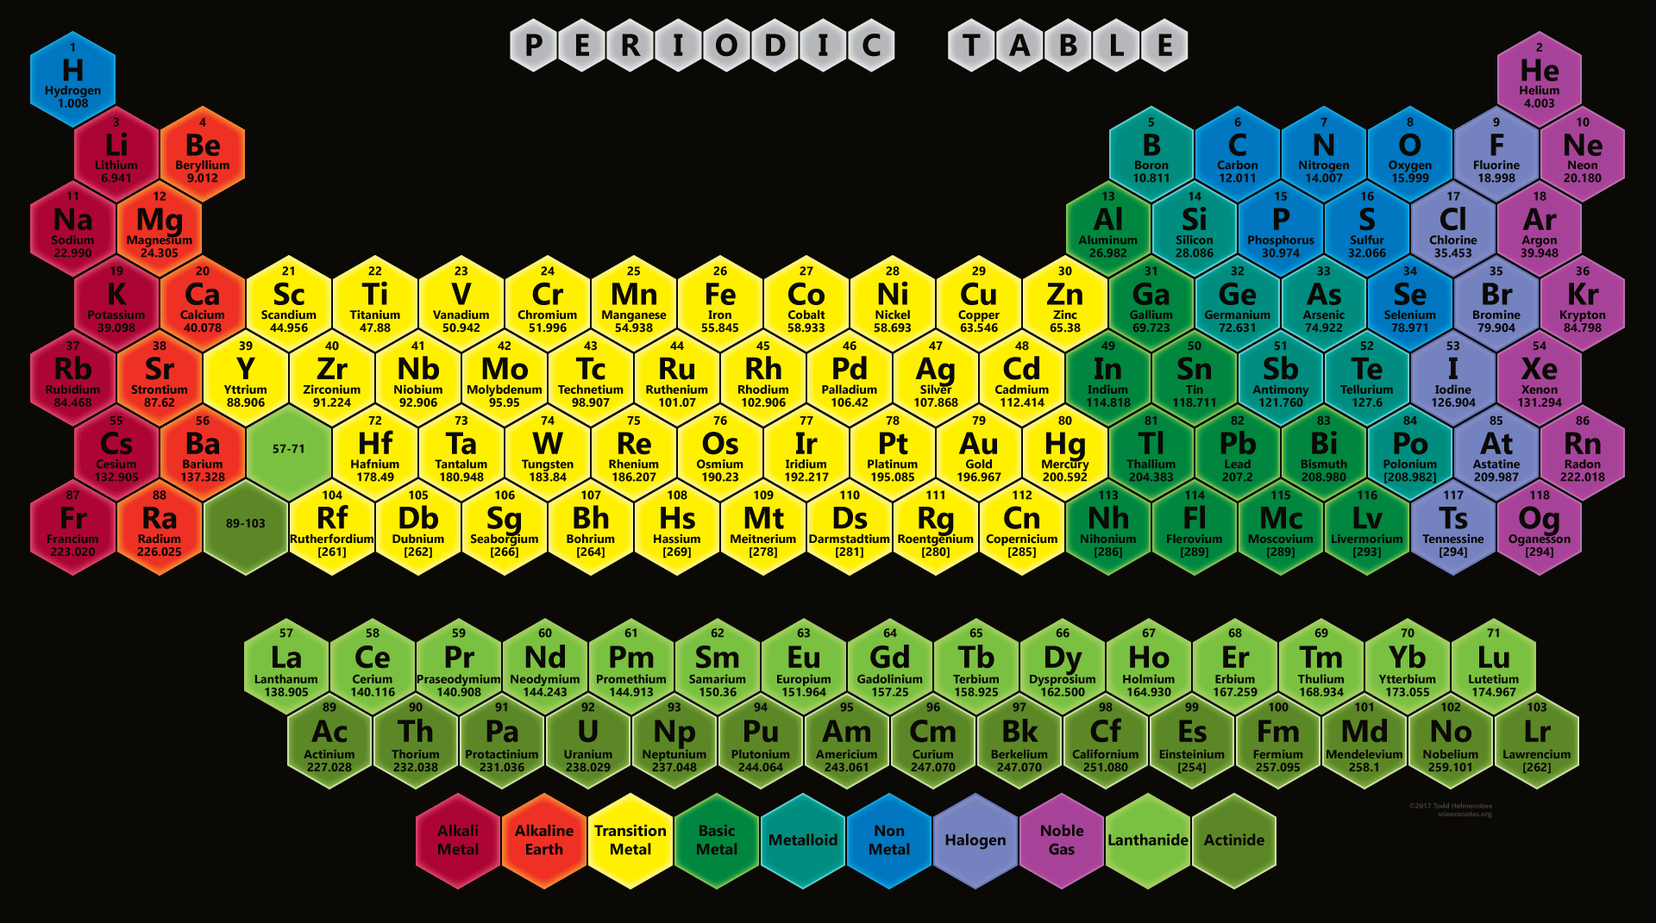
Transition metals
Ductile, malleable
Conduct electricity and heat
Valence electron present in more than one shell
Iron, cobalt, nickel → magnetic field

Slide 3
Physical properties
Silver-grey metal
Malleable
Ductile
Shiny
Good conductor
tensile
Ferromagnetic

Slide 4
Chemical properties
Non-toxic
With steam
With oxygen
hydrogen gas
iron oxide
rust
Dissolves in acids

Slide 5
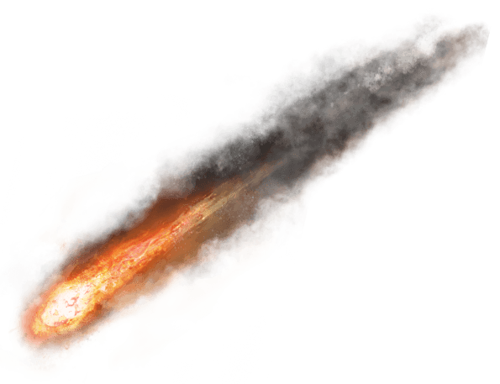
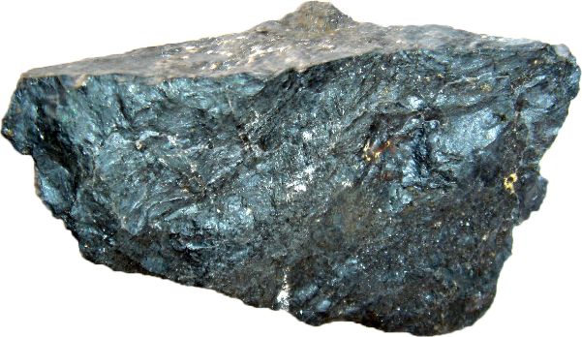
NATURAL OCCURRENCE
Rarely uncombine
Meteorites
Earth
Crust
Core
Limited extend
Soil
Groundwaters
ocean

Slide 6
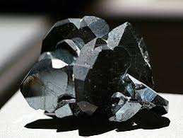
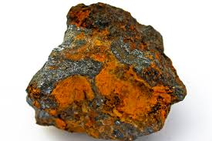
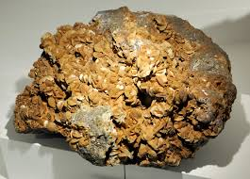
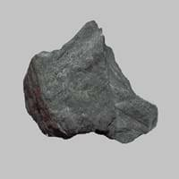
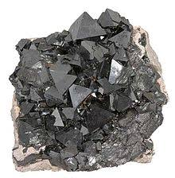
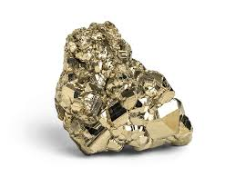
Ores
Hematite
Limonite
Siderite
Taconite
Magnetite
Pyrite

Slide 7
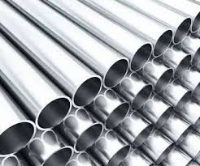
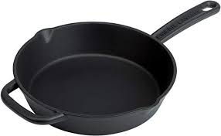
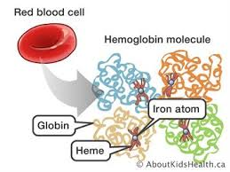
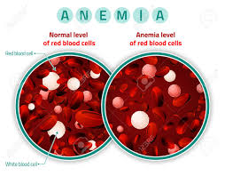
uses
Manufacture
Steel
Carbon (Ordinary)
Alloy
Stainless
Casting
Magnets
Biological role
Haemoglobin
Lack = anaemia

Slide 8
resources
https://www.livescience.com/29263-iron.html
https://www.britannica.com/science/iron-chemical-element/Compounds
https://www.rsc.org/periodic-table/element/26/iron
https://www.youtube.com/watch?v=HLLIn6thIsU
http://www.chemicalelements.com/groups/transition.html
https://www.infoplease.com/encyclopedia/science/chemistry/elements/iron/natural-occurrence

