Slide 1
Gold
Dominika Pjeczková , 3.BA

Slide 2
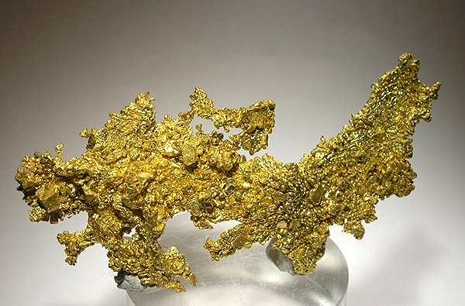
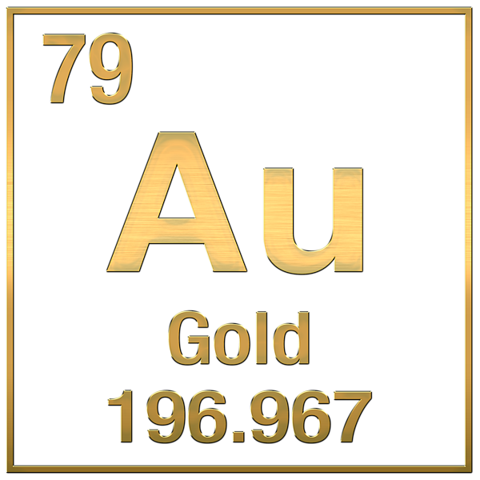
yellow, glossy, very durable, highly conductive, soft metal
not subject to corrosion
Inert = it does not react with any chemical agents → resistance

Slide 3
reacts only with aqua regia (in a ratio of 3:1, HCl : HNO3)
resistant to acids, bases and salts
But dissolves in the presence of oxygen in alkaline cyanide solutions
gold content in carats -purity rate
do not produce a characteristic flame colour

Slide 4
OCCURRENCE
Due to its inertness, it occurs only as pure metal in rocks
or in an alloy with silver (electrum)

Slide 5
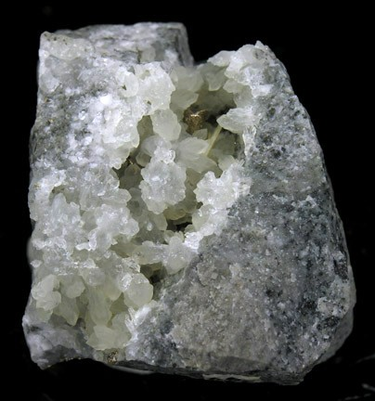
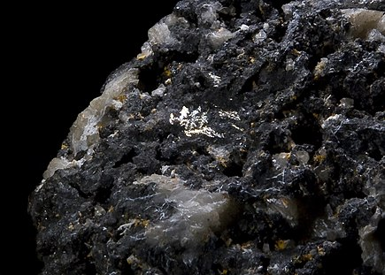
MINERALS
Krennerite (AuTe₂)
Sylvanite (AgAuTe 2)

Slide 6
PRODUCTION
“Rice” bearings
gold mining is done by cyanide leaching of gold-bearing rocks
The original bearings hydrothermal processes → gold is intruded into quartz veins and ingrown into pyrite on gold-bearing veins
The world's richest sites are in South Africa, the Urals, Australia

Slide 7
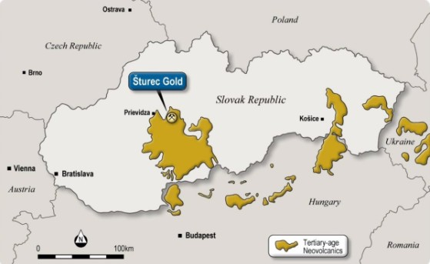

Slide 8
ECOLOGICAL RISKS OF GOLD MINING
contamination of the Danube cyanide from Romanian hydrometallurgical operations in the 90s of the 20th century
natural disaster - hundreds of tons of dead fish and animals
breaking the life balance of a territory for decades.

Slide 9
USAGE
in the chemical industry as a catalyst
COMPUTERS - in the microprocessor
MEDICINE - dentistry,implants

Slide 10
THE UNIVERSE- spacecraft,suits, especially helmets
ELECTRONICS - telecommunications technology,calculators, mobile phones or computers

Slide 11
COMPOUNDS
GOLD SALTS - ( ionic chemical compounds) - "Chrysotherapy" and "aurotherapy
HAuCl₄ ₋ purification of gold
AuCl3 - photography

Slide 12
THANK YOU :)

