Slide 1
Deforestation
Anna Novotová 5.BA

Slide 2
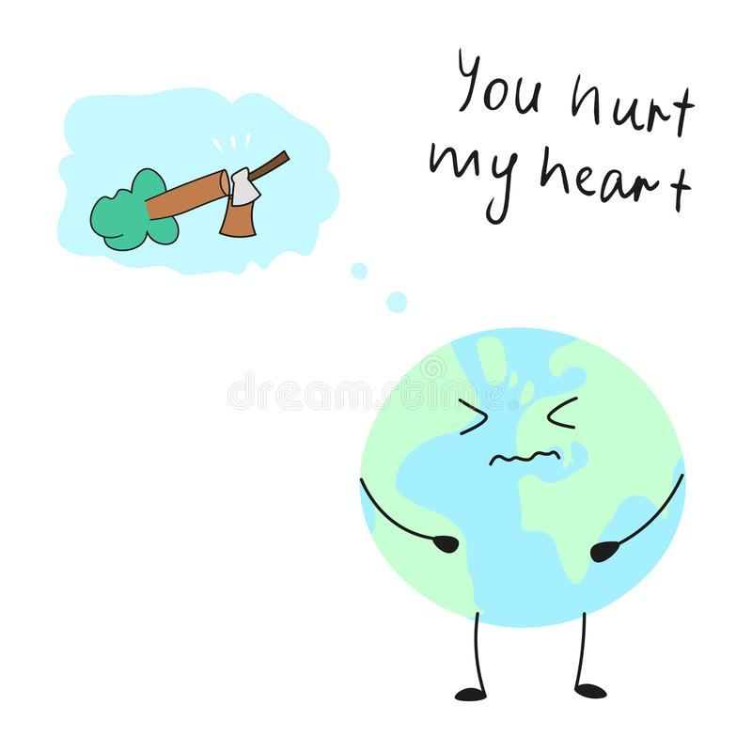
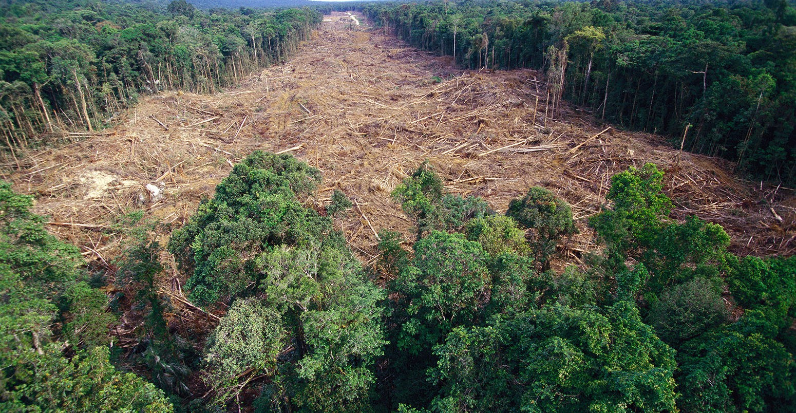
Why so dangerous ?
forest cover over 31% of the land
produce oxygen
home for the wildlife
can cause the extinction of some spieces

Slide 3
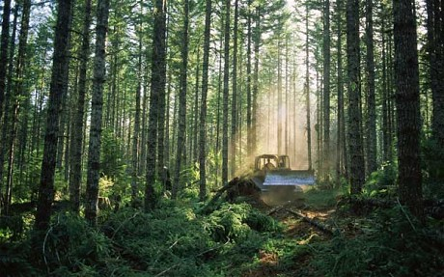
The cause
felling trees for wood → logging and cutting trees down
agriculture → farming, mining, grazing of livestock
in order to build housing → clearing of the land brought by growing population

Slide 4
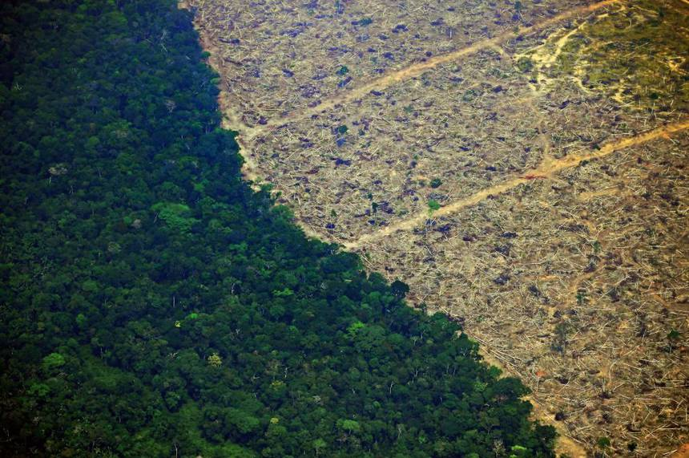
Current situation - AMAZON RAINFOREST
whole ecosystem could collapse within 50 years
amazon fires - caused every year during the dry season or thanks to farmers clearing land for crops or gazing

Slide 5
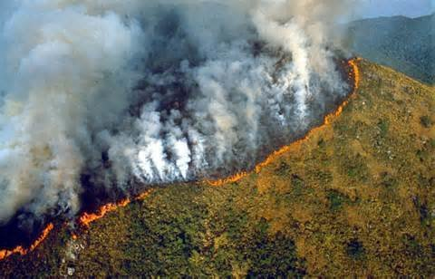
Current situation - INDONESIAN FOREST
constantly burning for four years
caused by the dry weather
another cause are the farmers who cleanse the area for palm oil using slash and burn method
similar scenario is occuring in Malaysia

Slide 6
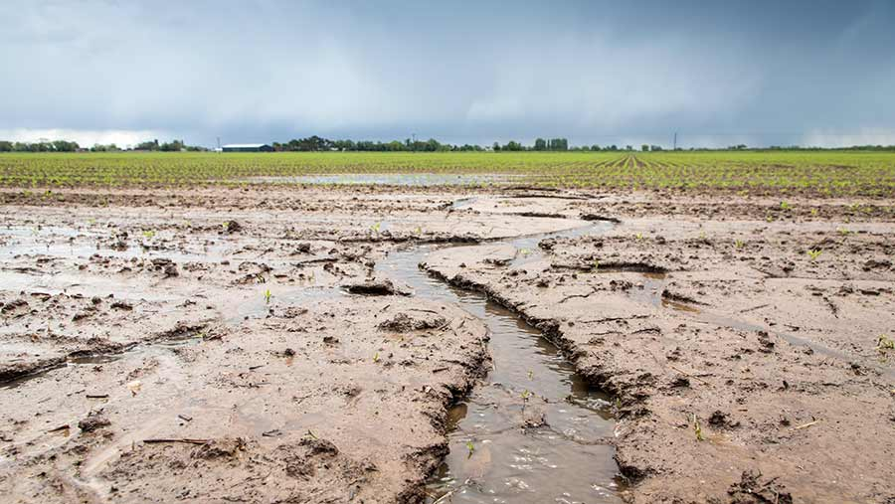
Effects - SHORT TERM
disruption of water cycles → local waters, trees keep the balance between water and land
soil erosion → sweep lands into rivers

Slide 7
Effects - LONG TERM
extinction → animals cannot survive in small areas, often accessible to hunters
climate change → main problem, as forests keep greenhouse emissions
greenhouse emissions → rising temperatures, extreme weather conditions and events, rising level of oceans
economical effects → destroyed sources of medicine, constant pressure on moving people from villages, floods

Slide 8
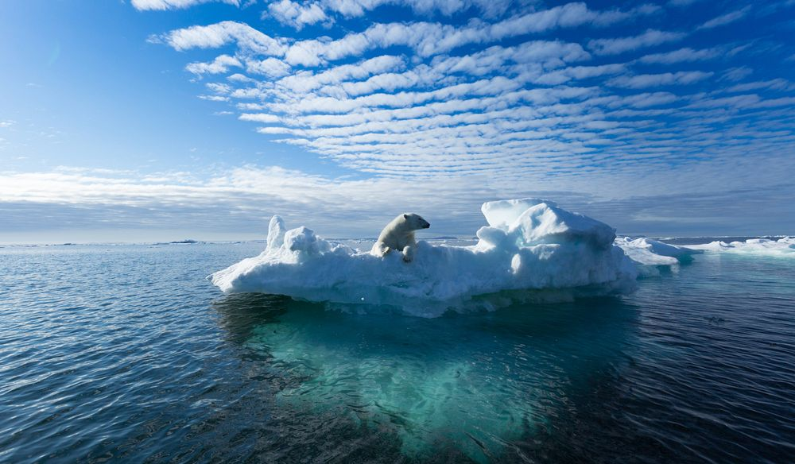
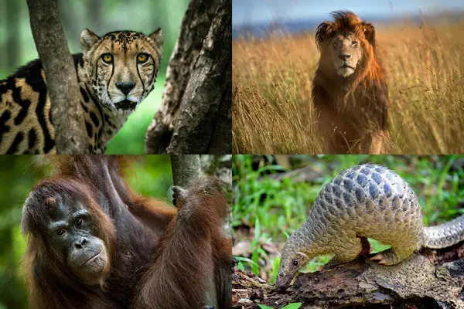

Slide 9
Solutions - GOVERNMENT
reforestation - replacing old trees for new ones
support green peace organisations → to spread their message and awarness troughout the world

Slide 10
Solutions - INDIVIDUALS
recycle
use more recycled products (cups, clothes…)
change food habits → buy local food, try to avoid eating meat
usage of renewable sources (geothermal springs, biomass..)
educate others about current situatio

Slide 11
THANKS FOR ATTENTION!

