Slide 1
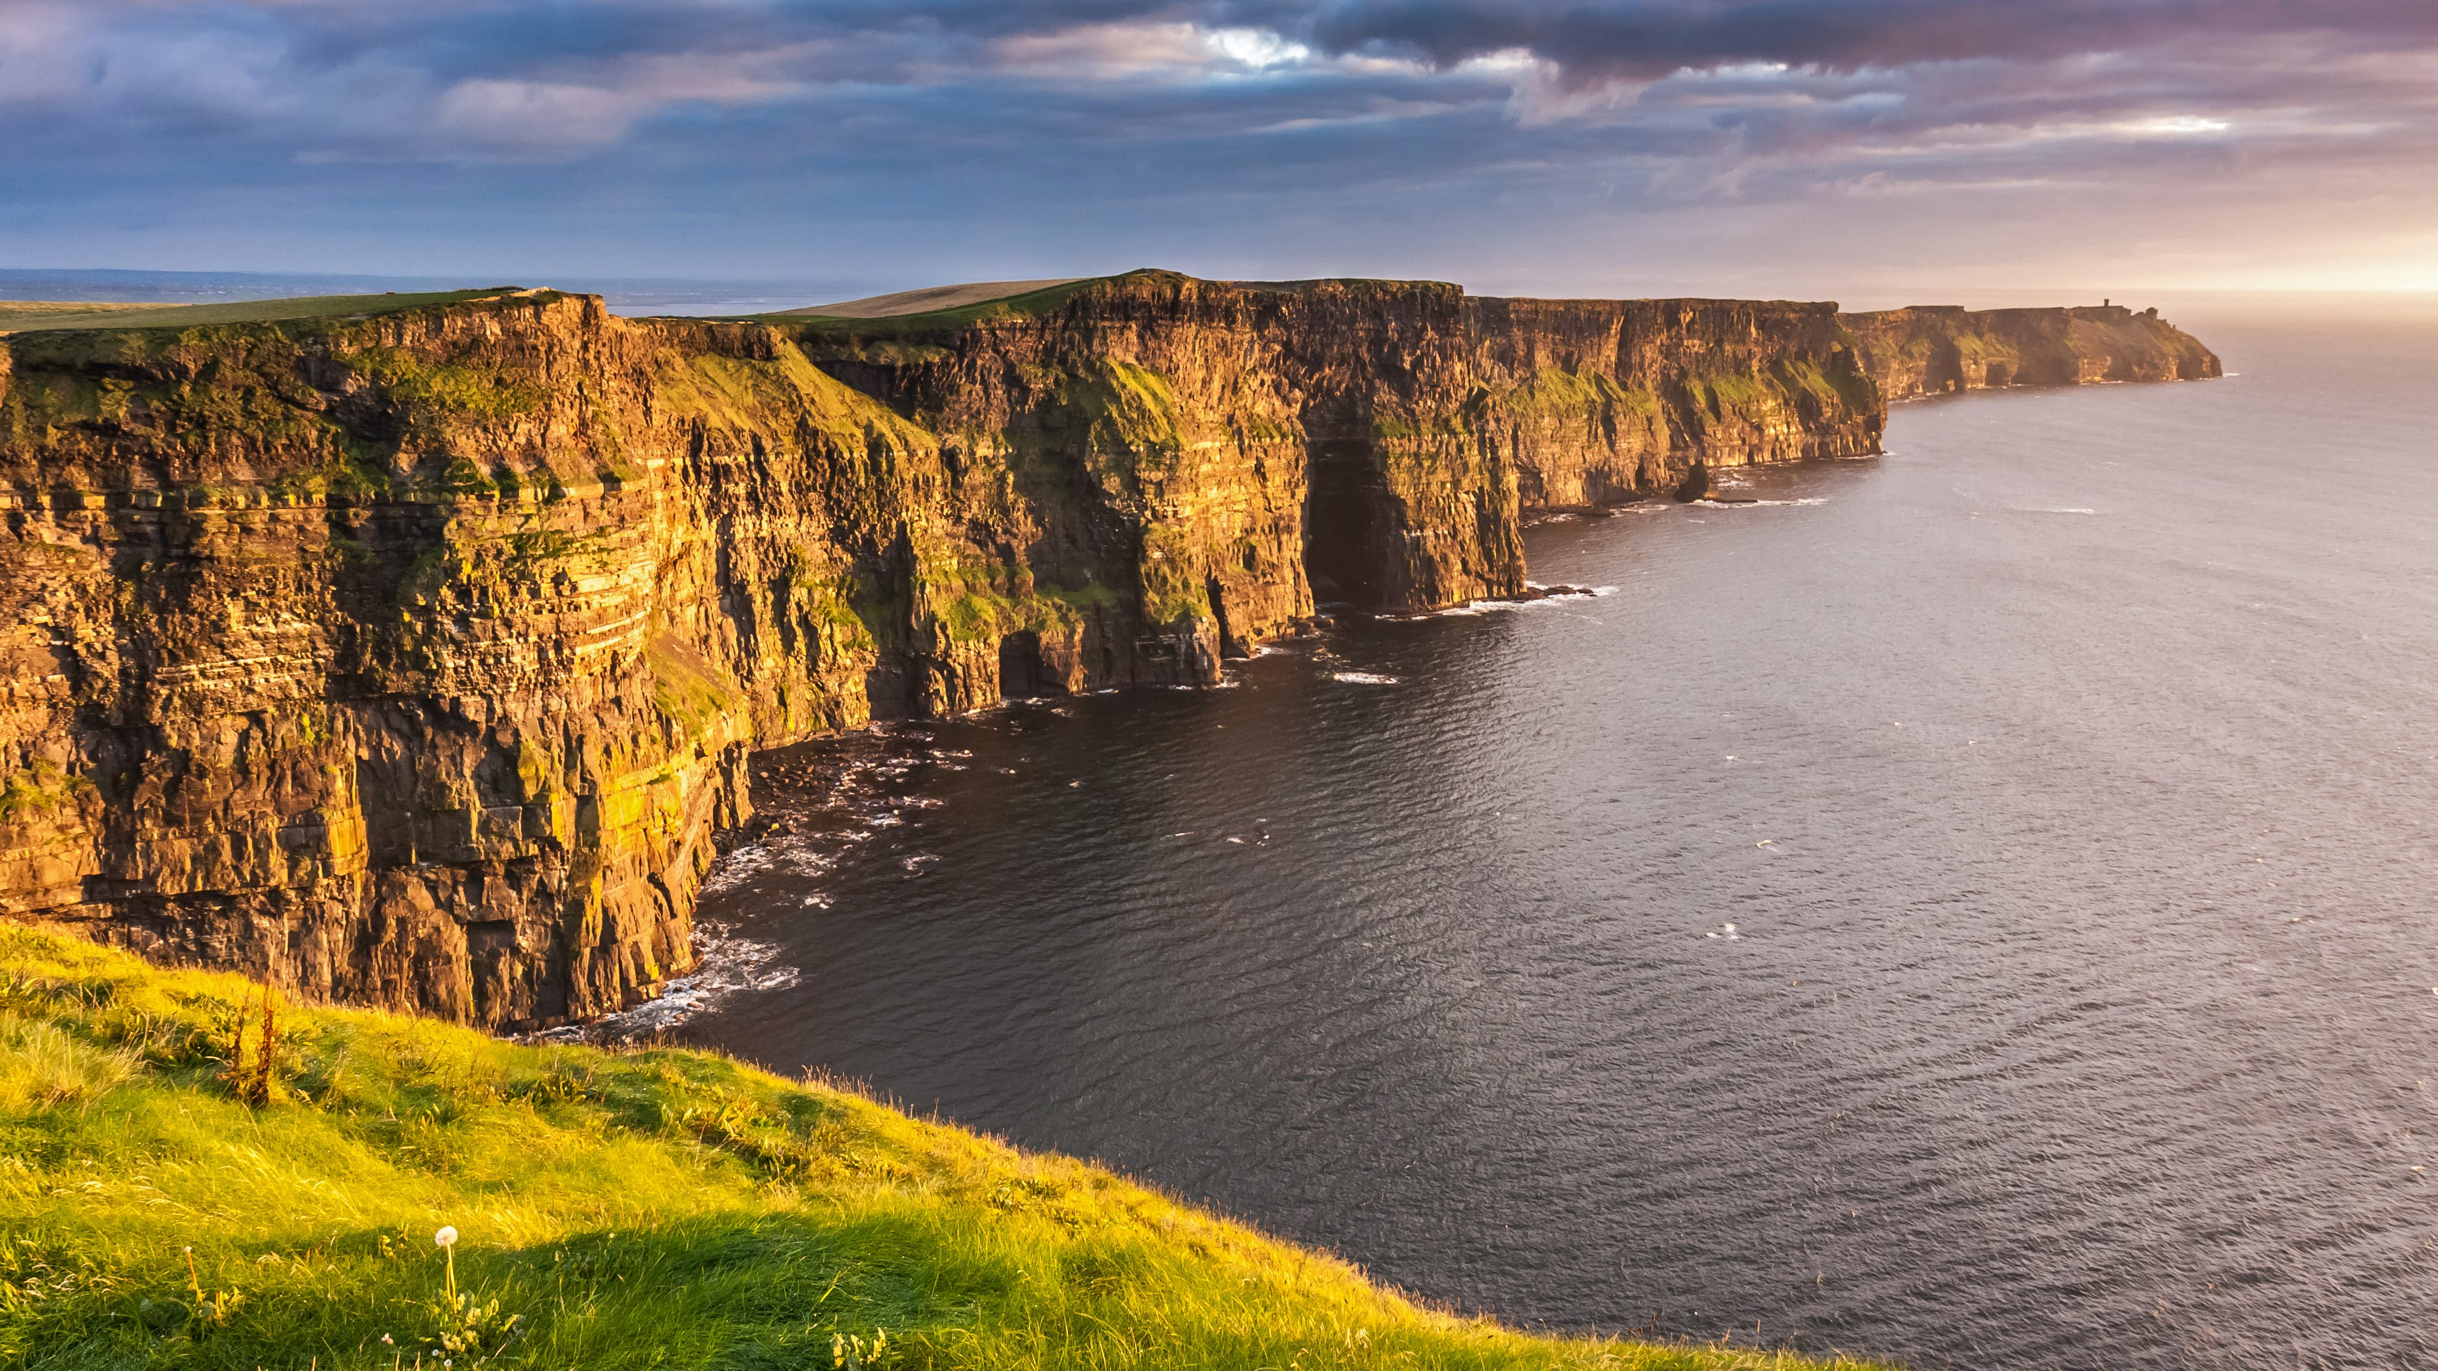
Irish music
Krištof Gabriel Novák, 1.BB

Slide 2
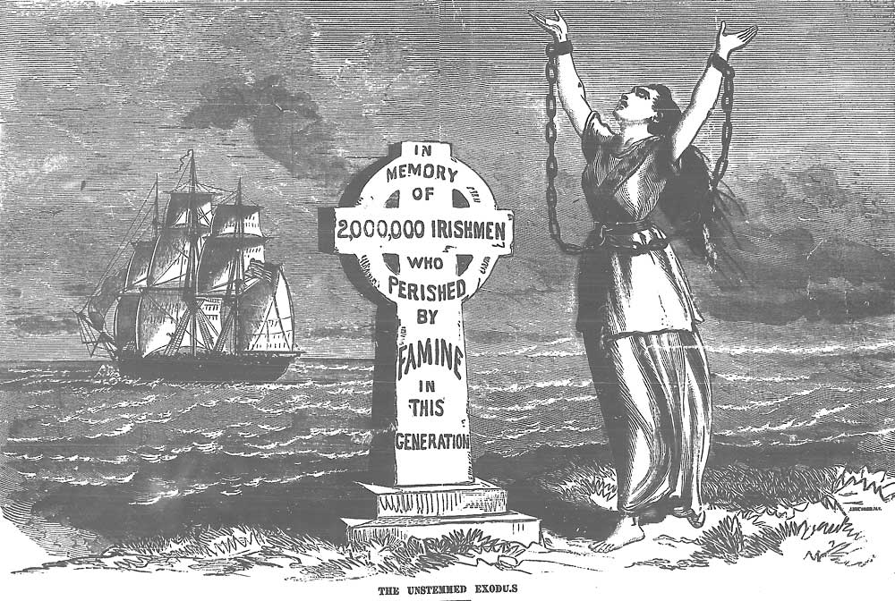
Great Famine
-was a period of mass starvation and disease in Ireland between 1845 and 1849
-during the famine, about one million people died and a million emigrated - it was about two thirds of population
-most of them emigrated to USA, Canada or Australia
-it spread Irish music around the world

Slide 3
Irish Folk
-also know like: Irish Music, Irish Traditional, Celtic Music, Celtic Folk https://www.youtube.com/watch?v=n39Kn4snKBE&ab_channel=DropkickMurphys-Topic

Slide 4
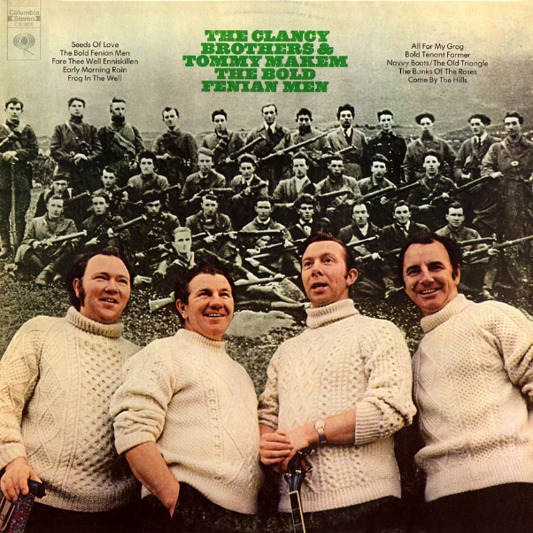
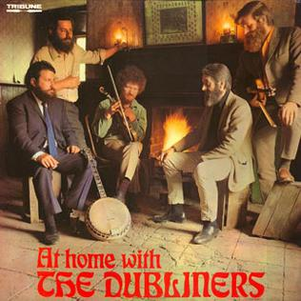
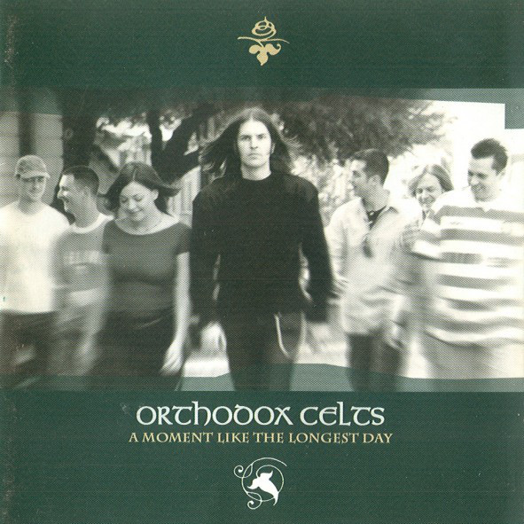
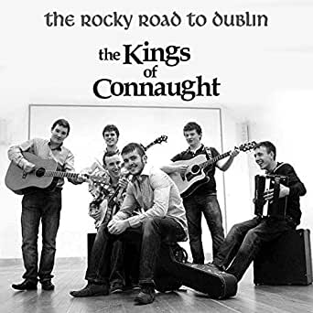
genre of folk music that developed in Ireland
Irish Folk instruments: clairseach (harp with 30 strings), timpan, feadan (fife), buinne (flute), cuislenna (bagpipes) and fiddle (violin)
Irish Folk bands: The Clancy Brothers, The Dubliners, Orthodox Celts, The Kings of Connaught

Slide 5
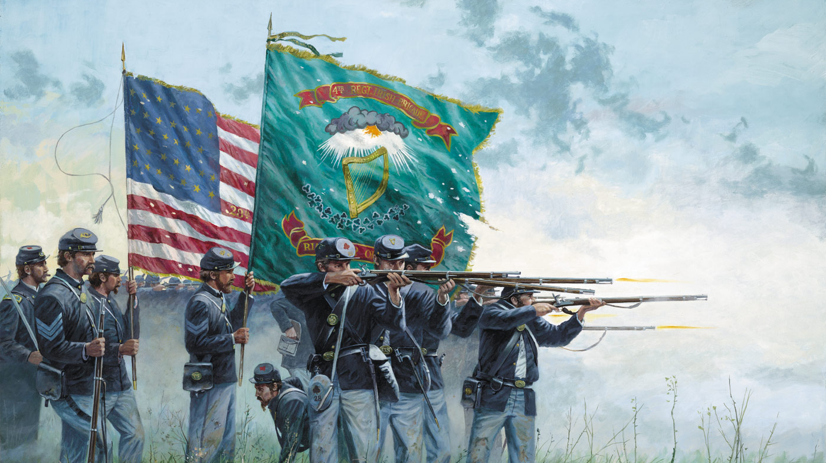
Songs of Irish Brigade
-Irish-American Civil War songs

Slide 6
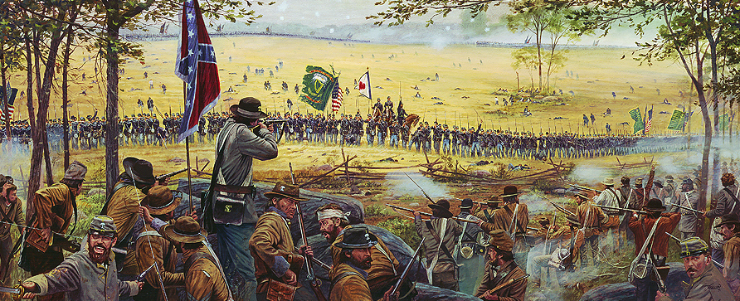
Irish Brigade was part of 69th New York Infantry – Union Army and they fought between years 1861-1865
Most of Irish Brigade soldiers were Irish which sang songs about war but with traditional Irish melodies
Sounds almost same like Irish traditional – same instruments + drums
Performers: David Kincaid, Tenessee Ernie Ford

Slide 7
Modern Irish Music

Slide 8
Irish Rock
Beginnings in 1960s and 70s in Boston
On same basis like Irish Folk but modernized with new instruments – electric guitar, bass
Irish Rock Bands: The O'Reillys and the Paddyhats, The Rumjacks, Dropkick Murphys
Notes:
-

Slide 9
Irish Punk
Celtic Punk, Folk Punk
popularized in the 1980s in London
Same instruments like Irish Rock
Bands - Flogging Molly, Dropkick Murphys
https://www.youtube.com/watch?v=c2bEwZR7g1Y&ab_channel=Paddyhats

Slide 10
Irish Rebel Songs
-Songs about armered rebellions against GB
-Artists : The Clancy Brothers and Tommy Makem, The Dubliners, The Irish Brigade
https://www.youtube.com/watch?v=rMXjr6wLUiI&ab_channel=DavidKincaid-Topic

