Slide 1
electronic music
Daniel Deluxe | Blue Stahli
Polina Kostyletska, 2.BB

Slide 2
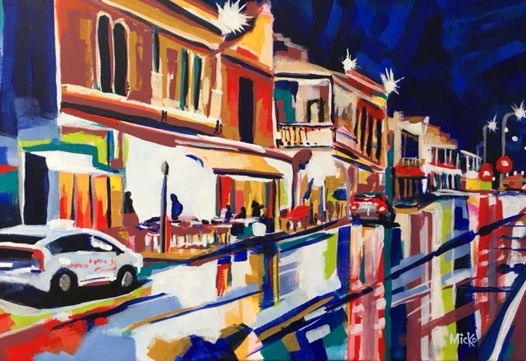
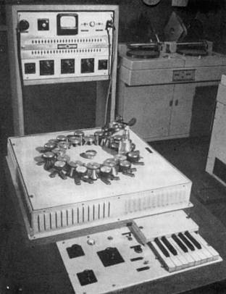
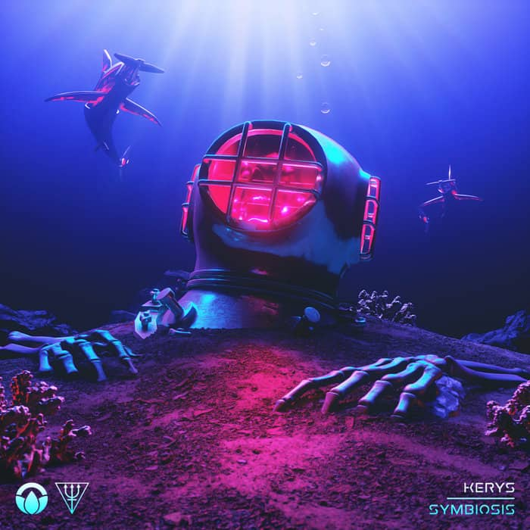
electronic music
Is the music that employs electronic, digital musical instruments, circuitry-based music technology.
Stylistic origins: Modernism, Futurism.
Appeared in late 19th & early 20th century
Has many styles: Breakbeat, Electro, Trance, Synth-pop, Techno, Electropop, Dubstep, House (garage house, future garage)…
As well as experimental forms – Electroacoustic music, Glitch, Industrial music.

Slide 3
Daniel Deluxe
Daniel Deluxe, or Daniel Alexandrovich.
Music producer, mainly working with electronic and retrowave.
Daniel has toured Europe and the USA a few times.
In 2017 was ranked as one of the top retrowave artists.
◈ Retrowave, or synthwave - is based on the use of synthesizers, closely related to nostalgia (1980s and later)

Slide 4
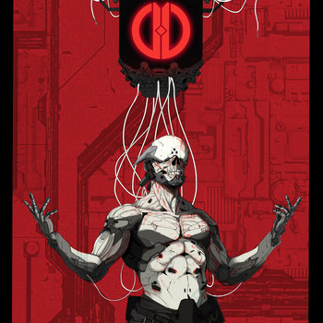
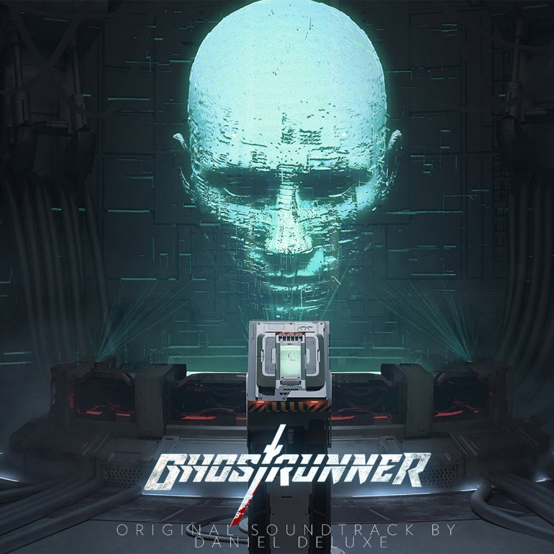
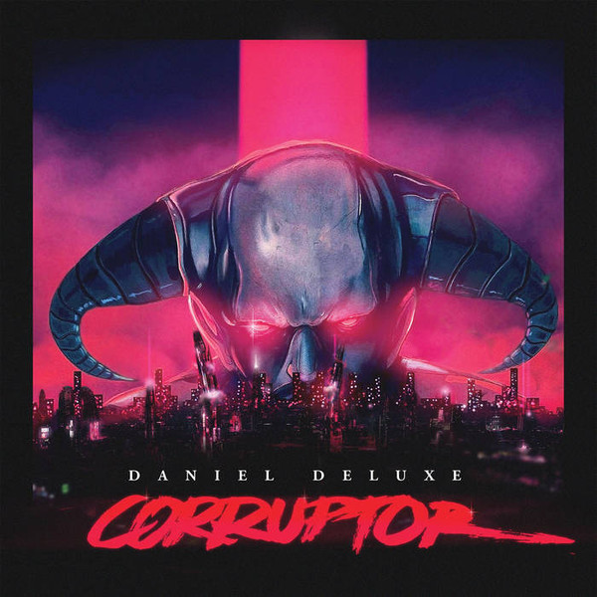
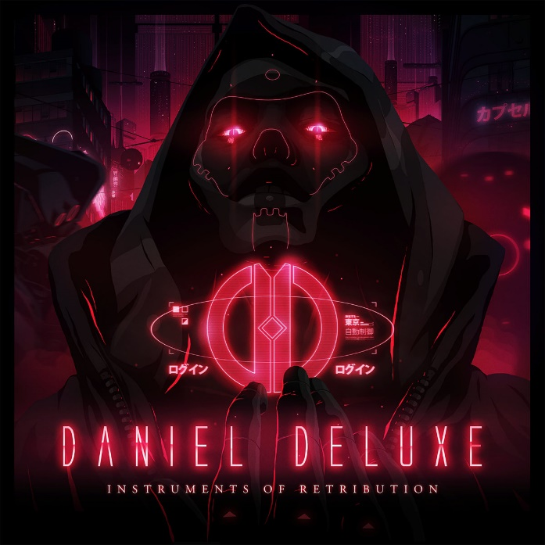
Daniel Deluxe
Since 2016 he has produced several albums and original soundtracks.
He produced the original soundtracks for the action games Ghostrunner and DESYNC.

Slide 5
Blue Stahli
Blue Stahli is a project of multi-instrumentalist Bret Autrey.
Directions of the music: Elektronic-Rock, Breakbeat, Metal, Hybrid.
Blue Stahli was never on the stage.
The name «Blue Stahli» is a synthesis of the painting's name and the name of the artist:
Susanne Stähli + Untitled Blue
«Untitled Blue»

Slide 6
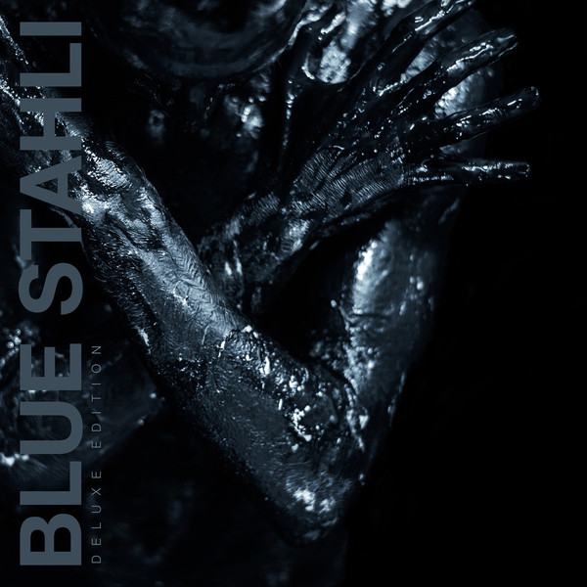
Metamorphosis (1)
ULTRAnumb (2)
The Destroyer Of All Things (1)
Suit up (2)
Rockstar (1)
Demon (2)
The Fall (3)
◈ Blue Stahli – second, first vocal album. Most of the songs was already released as singles.
◈ The devil – fifth album. Was released in chapters.
◈ ANTISLEEP – an album for films & TV.

Slide 7
Aleksander zatsepin - main theme
Was it electronic music?
Does it have a particular style/form?
Synthwave/retrowave.
The music is soundtrack from movie: The Mystery of the Third Planet.

Slide 8
C418 – moog city 2
Was it electronic music?
Does it have a particular style/form?
Electronic/dance.
Soundtrack from Minecraft.

Slide 9
C418 – pigstep
Was it electronic music?
Does it have a particular style/form?
Future garage, (classic/post-) Dubstep
Soundtrack from Minecraft.

Slide 10
Alias Conrad Coldwood - windows licking
Was it electronic music?
Does it have a particular style/form?
Album’s genres: Electronic, (dark) Ambient, Downtempo, Industrial
“Sweet blend of electro hovering and rhythmic, sometimes fun and sometimes scary "

Slide 11
Thank you for (listening) watching
<|◦_◦|>

