Slide 1
Radiohead and ajj
Lucia Paráková

Slide 2
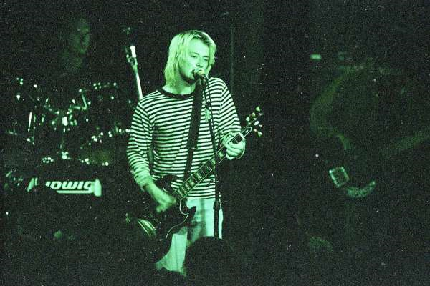
Radiohead
Formed in 1985 in abindgon, oxfordshire
Met in abdingon school
Thom yorke, jonny greenwood, colin greenwood, ed o'brien, philip selway
Known for their experimenting in music
1992 first single Creep, ( Pablo honey album)
1995 second album The bends
A kid released in the 2000s with a dramatic change
2003 Hail to the thief and 2007 In rainbows
2011 king of limbs
2016 A moon shaped pool

Slide 3
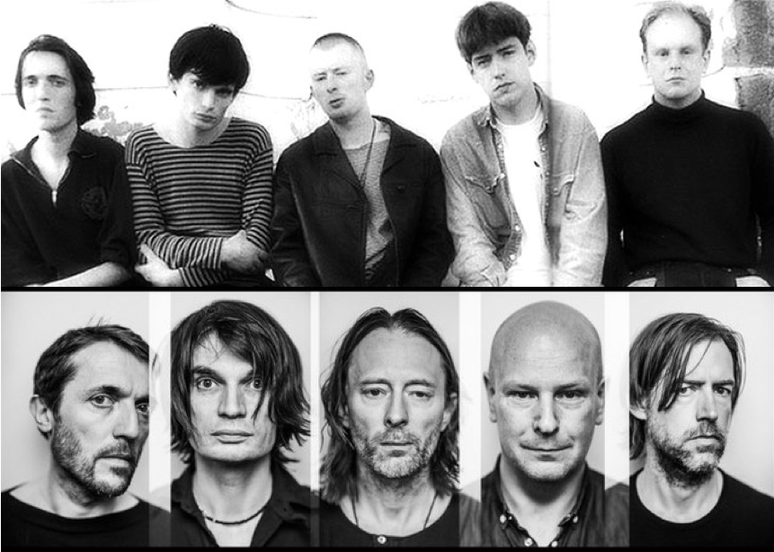
1 Colin greenwood
2 Johny greenwood
3 Thom yorke
4 Phil selway
5 Ed o'brien

Slide 4
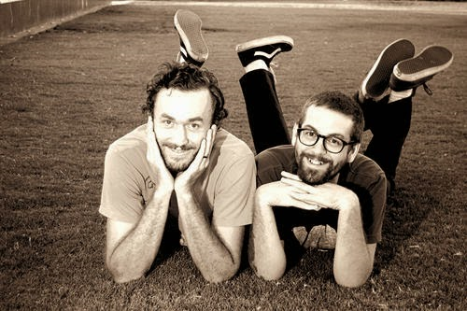
AJJ
Folk punk
AJJ formerly known as andrew jackson jihad
Formed in phoenix, arizona
Created in 2004
Core members Sean bonnette and ben gallaty
Met as teenagers
Self-realesed album (candy cigarettes & cap guns) in 2005

Slide 5
AJJ
Later changed record label (asian man records)
Touring and new members Preston Bryant, Deacon Batchelor
Release of their fifth album under a new record label
Official name change
They relabeled all their previous albums due to a scandal
2020 realesed their album under new label (AJJ unlimited LTD)

Slide 6
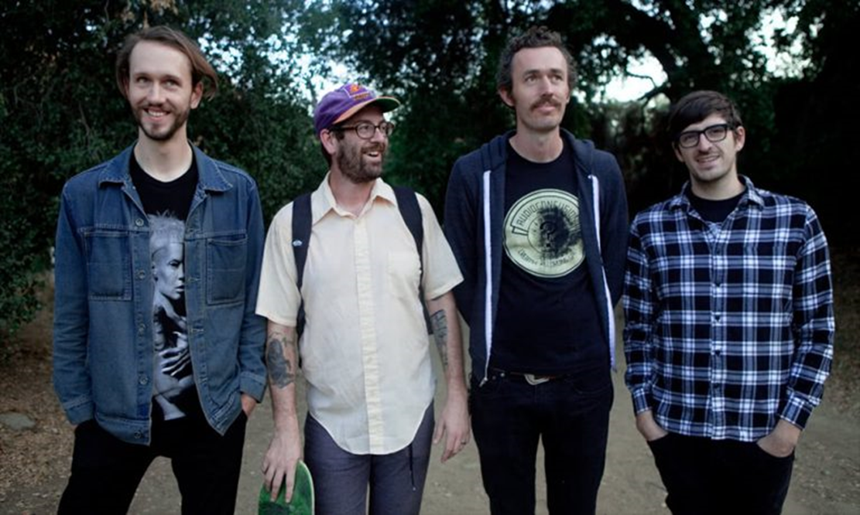
1. Preston Bryant
2. Sean Bonnette
3. Ben gallaty
4. Mark glick

Slide 7
Song example
Radiohead - Fake plastic trees : https://www.youtube.com/watch?v=n5h0qHwNrHk
AJJ – bad bad things:https://www.youtube.com/watch?v=HutFfYK2L20

Slide 8
activity
1. Are the main differences between radiohead and ajj?
2. How many members did each group have?
3. Name one of AJJs album names.
4. How many albums have radiohead sold in 2011?
5. What genre of music did AJJ play?
6. Does this album cover photo belong to AJJ or Radiohead?

Slide 9
Thank you for listening to my presentation

