Slide 1
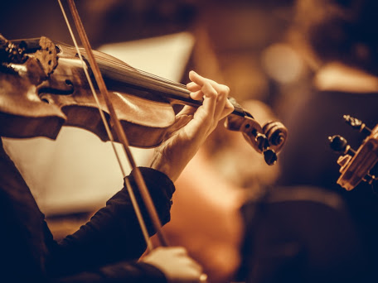
Classical music
Aleksandra Bajzíková 2.BB

Slide 2
Informations
1750 – 1820
Between the baroque and the romantic periods
1550 – 1945
Joseph Haydn, Wolfgang Amadeus Mozart, Ludwig van Beethoven and Franz Schubert
“Viennese classic“ or
“classicism“
Strings instruments,
bass intruments

Slide 3
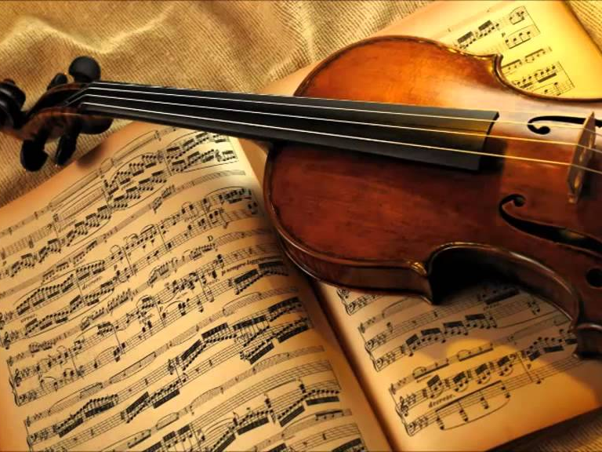
Genres of classical music
1. Sonata
https://www.youtube.com/watch?v=5-MT5zeY6CU
2. Symphony
https://www.youtube.com/watch?v=bnK3kh8ZEgA
3. Opera
https://www.youtube.com/watch?v=TdWEhMOrRpQ
4. Operetta
5. Dance music

Slide 4
Frédéric Chopin
Composer and pianist of the Romantic period
Born 1 March 1810
Died 17 October 1849
Warsaw Lyceum
https://www.youtube.com/watch?v=dN1XUV6QclU

Slide 5
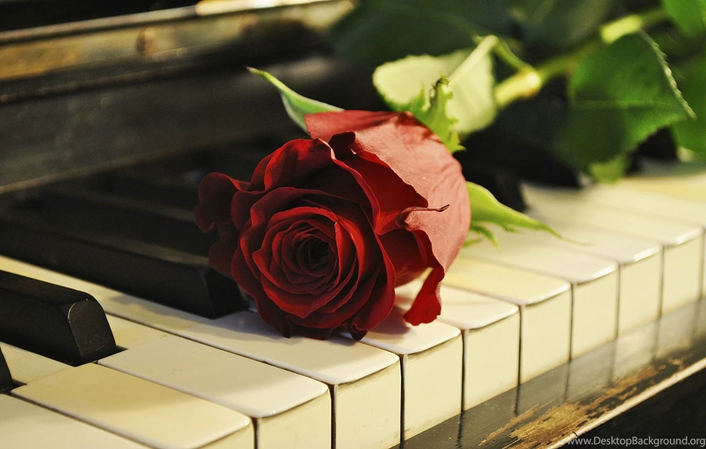
Activity
1. What are the typical classical musical intruments?
2. What classical composers do you know?
3. Guess the composer and the title of the song.

Slide 6
Thanks for paying attention!

